Slide 1
UAV Development Guide
Daro Van

Slide 2
Outline
High-Level Architecture
Development Progress

Slide 3
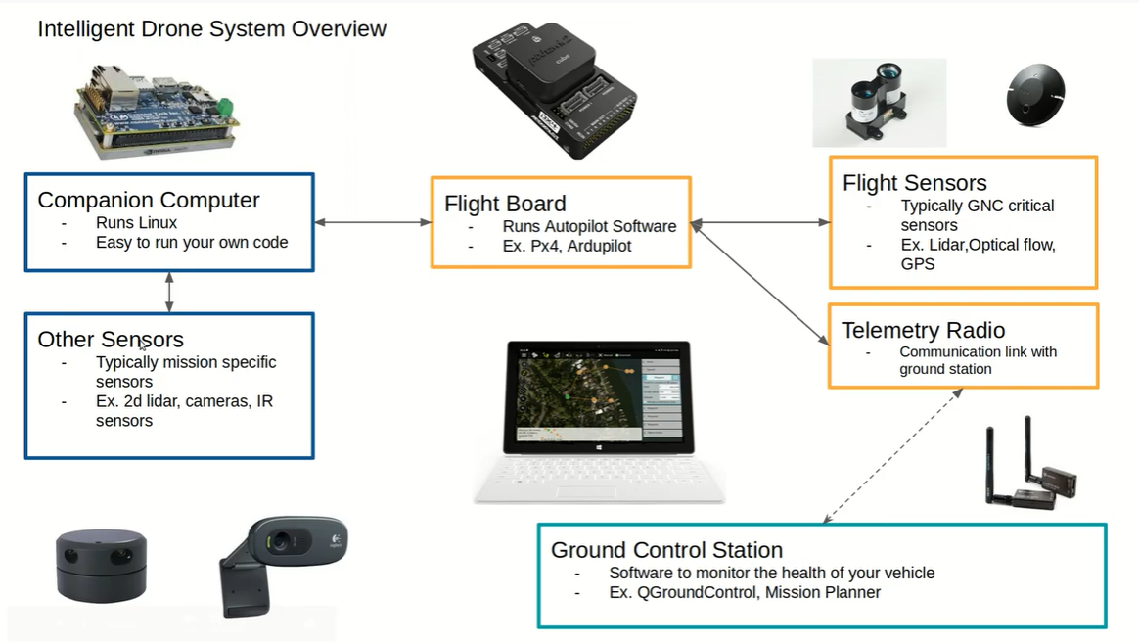
High Level Drone Dev

Slide 4
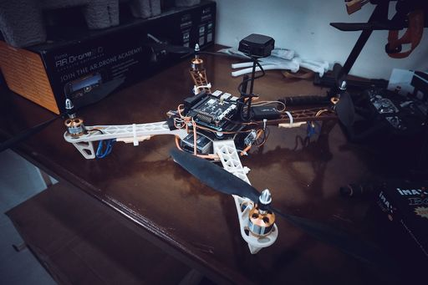
High Level Drone Dev
Current Software development

Slide 5
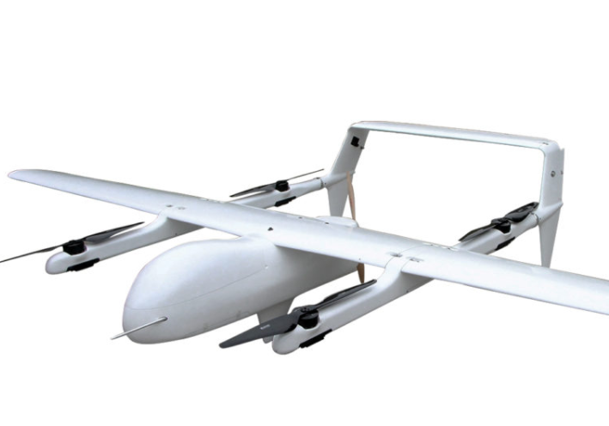
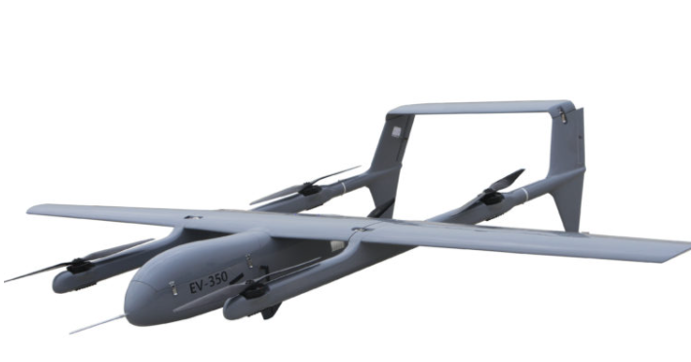
High Level Drone Dev
Mugin EV460 Full Electric Carbon Fiber UAV
Mugin EV350 Full Electric Carbon Fiber UAV
https://www.youtube.com/watch?v=Ln4Sh1gmDpM
https://www.youtube.com/watch?v=VhASWFjDmAw
https://www.muginuav.com/product/mugin-ev460-full-electric-carbon-fiber-uav-platform-10kg-payload/
https://www.muginuav.com/product/mugin-ev350-carbon-fiber-full-electric-vtol-uav-platform/

Slide 6
Dev Workstation and Dependency

Slide 7
Ardupilot and SITL
About Ardupilot
Over 700,000 lines of code
Advanced Kalman Filter to fuse sensor inputs into one altitude and position estimation
Support many vehicle types: multirotor, helicopter, fixed-wing, VTOL, Rover, Submarine, Antenna Tracker
Active community of talented developers
Wide variety of hardware's choice

Slide 8
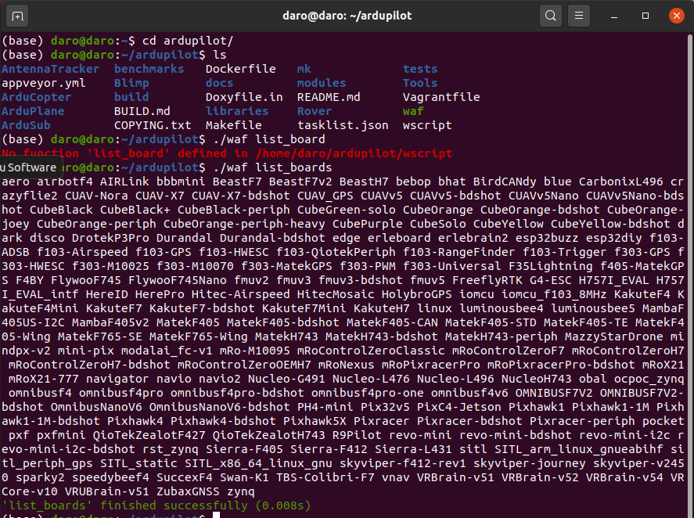
Ardupilot and SITL
Installation Guide
https://ardupilot.org/dev/docs/building-setup-linux.html
Build in ArduPilot
All the vehicles share the same code in libraries. Once you compile the code, build directory will be made.
The tool to build is waf. We need to specify the vehicle type and the hardware target we compile to.
Ex check the support hardware using ardupilot$ ./waf list_boards

Slide 9
Ardupilot and SITL
Flight modes in ArduPilot
A flight mode is a particular way in which the drone can be controlled.
For example:
Stabilize flight mode: Uses exclusively RC Input from the pilot to control the drone
Loiter flight mode: Uses GPS/Barometer and other sensor inputs to automatically hold the drone at the desired place in 3D space without requiring input from the pilot
Primary flight modes: GUIDED, AUTO, RTL, LAND
More info:
https://ardupilot.org/copter/docs/flight-modes.html

Slide 10
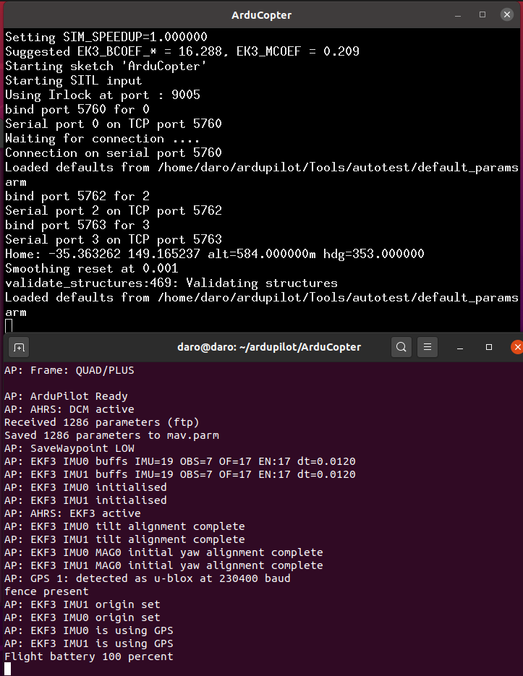
Ardupilot and SITL
SITL Simulator (Software in the loop)
What does sim_vehicle.py do?
Launches our simulated drone with four main
Detects what vehicle to build for (Copter, Plane, Rover, etc.) launch sim_vehicle from ArduCopter means that the vehicle type is copter $sim_vehicle.py --map --console
Compiles the necessary source code into an executable
Launches the simulated drone by running the SITL executable
Launches MAVProxy to communicate with/command the SITL drone

Slide 11
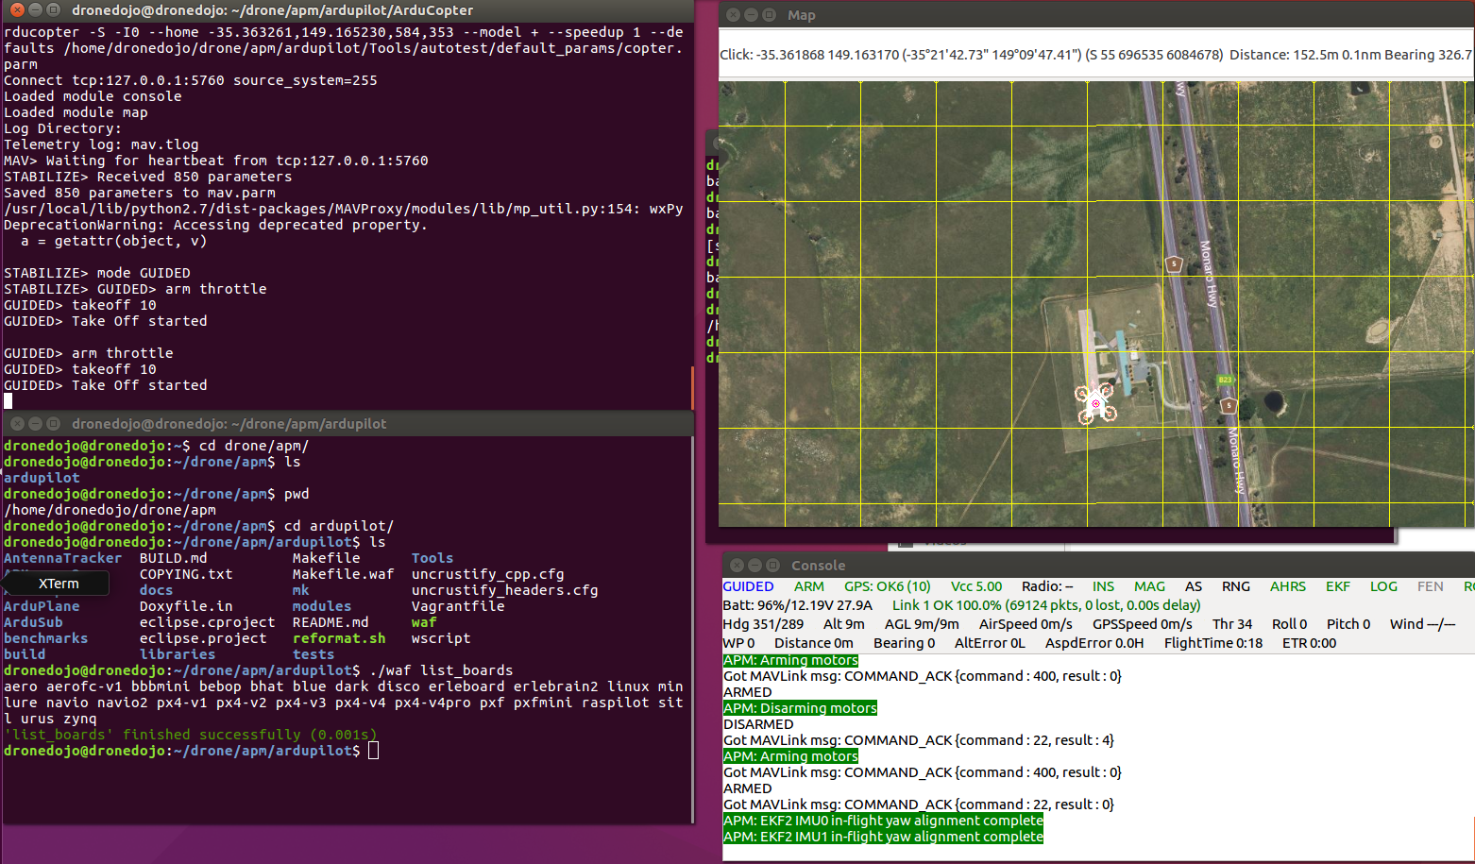
Ardupilot and SITL
SITL Simulator (Software in the loop)
STABILIZE> mode GUIDED
GUIDED> arm throttle
GUIDED> takeoff 10

Slide 12
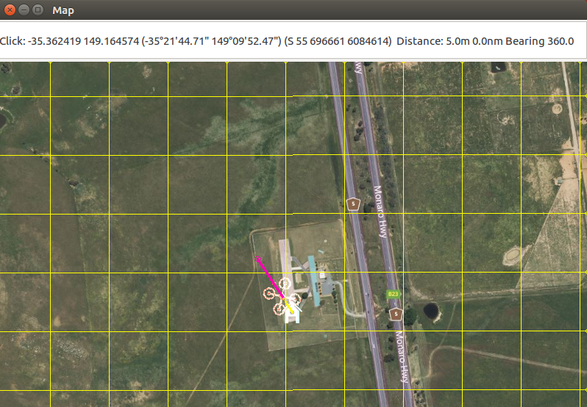
Ardupilot and SITL
SITL Simulator (Software in the loop)

Slide 13
Ardupilot and SITL
Parameter in ArduPilot
A variable that can be set to different numbers to change some of the drone’s settings/configuration or behavior
Example parameters:
RTL_ALT (cm): The height the drone will fly to when switched into RTL mode.
BATT_CAPACITY (mAh): A number that is set to the milli-amp-hours of the battery that is being used on the drone. This may be used in the calculation of the remaining battery life.
ANGLE_MAX (centi-degrees): The maximum angle the drone will be able to pitch/roll to.
Check the parameter
Modify parameter
ArduCopter$ ls mav.parm
ArduCopter$ wc –l mav.parm
ArduCopter$ cat mav.parm
$cat mav.parm | grep RTL_ALT
http://ardupilot.org/copter/docs/parameters.html

Slide 14
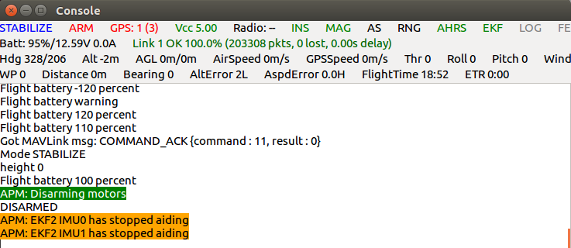
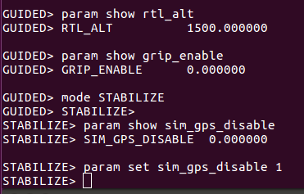
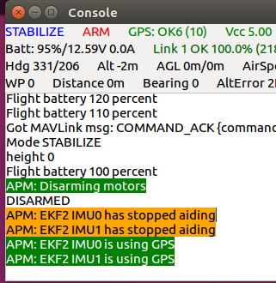
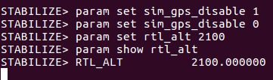
Ardupilot and SITL
Parameter with SITL Drone and MAVProxy
New MAVProxy commands
param show <PARAMETER NAME>
Param set <PARAMETER NAME> <VALUE>
Ex. $param show rtl_alt
Ex. $param set rtl_alt 4000

Slide 15
Ground Control Station
It is an interface to the done that gives the pilots a way to communicate with the
Drone
This interface can be used to command the drone or simply receive the info updates (GPS health, battery, speed, etc)
GCS can refer to the hardware setup of the ground control station, or the high level software that presents all the incoming data with a GUI

Slide 16
Ground Control Station
What is MAVProxy?
A command-line GCS that is lightweight (requires very little resources)
Open source GCS wrote in python
Can be used to share Drone-GCS connections with other ports/GCS
Where can I learn more about MAVProxy?
https://ardupilot.github.io/MAVProxy/html/index.html
How to connect MAVProxy to Drone?
Using the IP Protocol to connect MAVProxy with the drone:
The drone will offer an open port that a GCS can connect to.
For SITL drone, the port is tcp:127.0.0.1:5760
Remember, this is the DRONE SIDE port that the GCS connects to.
To connect MAVProxy to the drone's 5760 port:
*** mavproxy.py --master tcp:127.0.0.1:5760
This will establish a connection with the drone and launch a MAVProxy terminal, where you can interact with the drone.

Slide 17
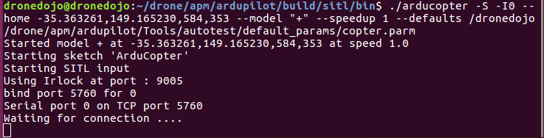
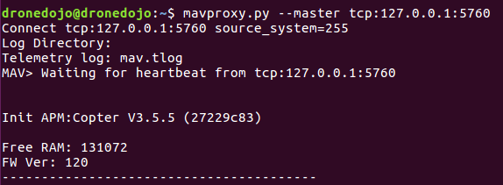
Ground Control Station
Connecting Mavproxy to SITL drone
Ground control station on mavproxy

Slide 18
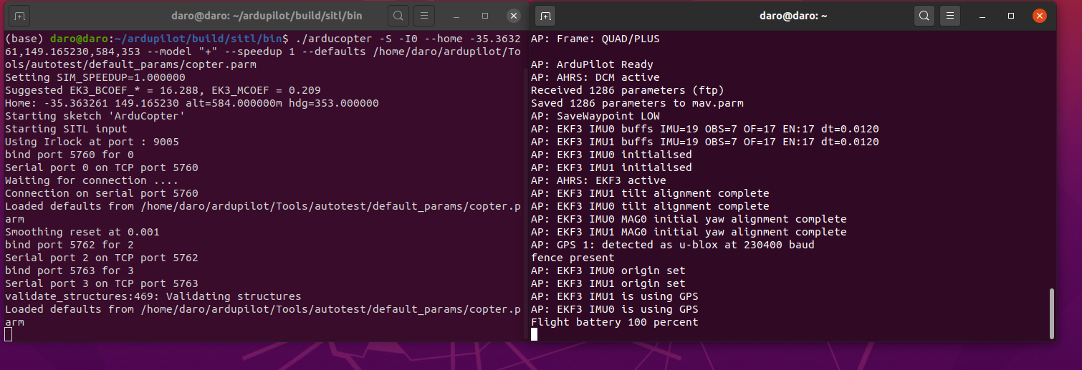
Ground Control Station
Connecting QGroundControl to SITL drone
Inside the ArduCopter executable:ardupilot/build/sitl/bin$
./arducopter -S -I0 --home -35.363261,149.165230,584,353 --model "+" --speedup 1 --defaults /home/daro/ardupilot/Tools/autotest/default_params/copter.parm
Connecting mavproxy in another terminal
mavproxy.py --master tcp:127.0.0.1:5760 --out udp:127.0.0.1:14550

Slide 19
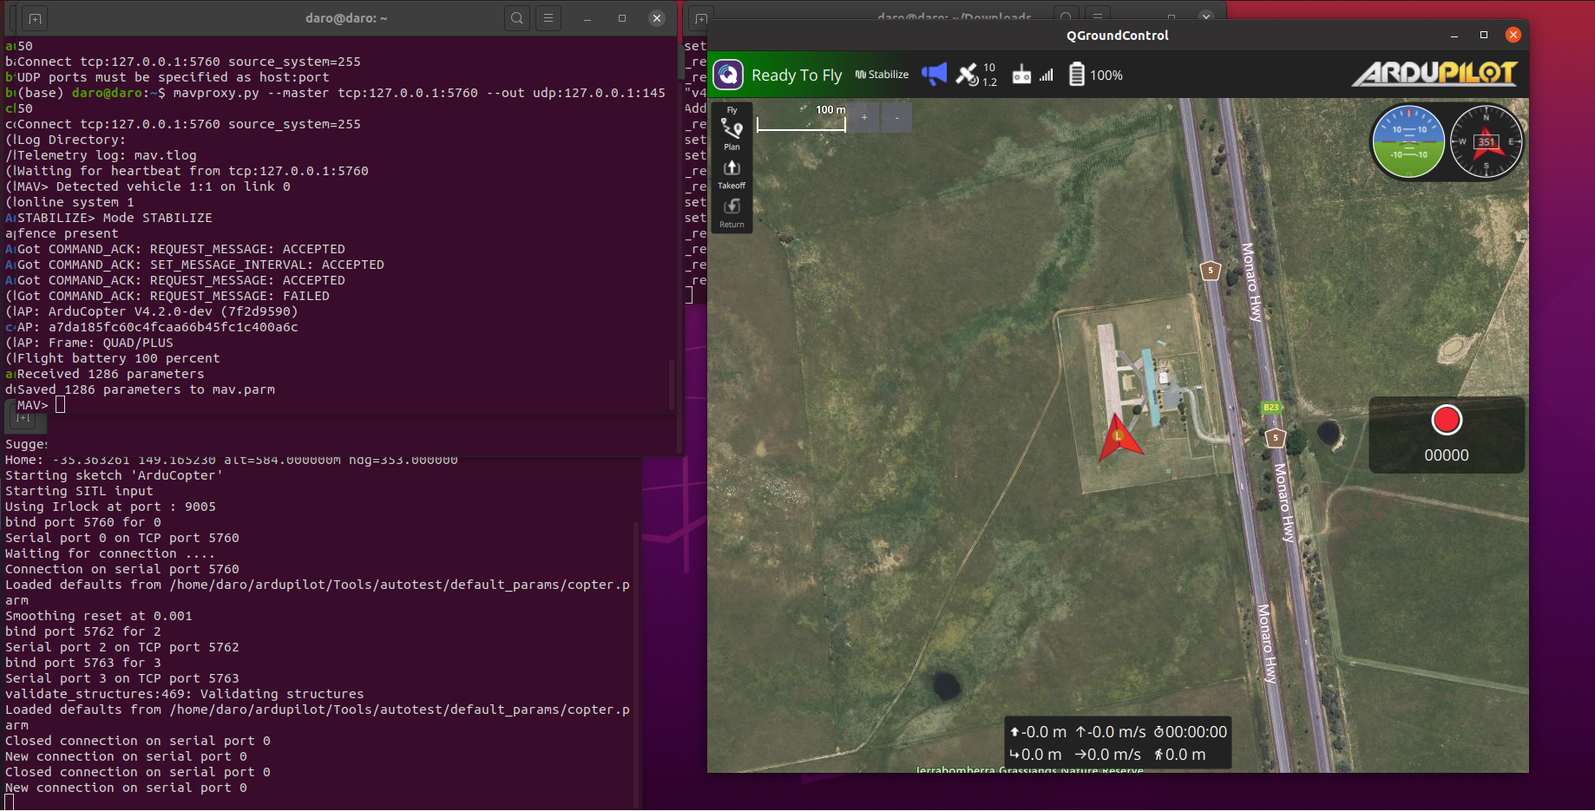
Ground Control Station
Connecting QGroundControl to SITL drone
Connecting SITL to QgroundControl via Mavproxy

Slide 20
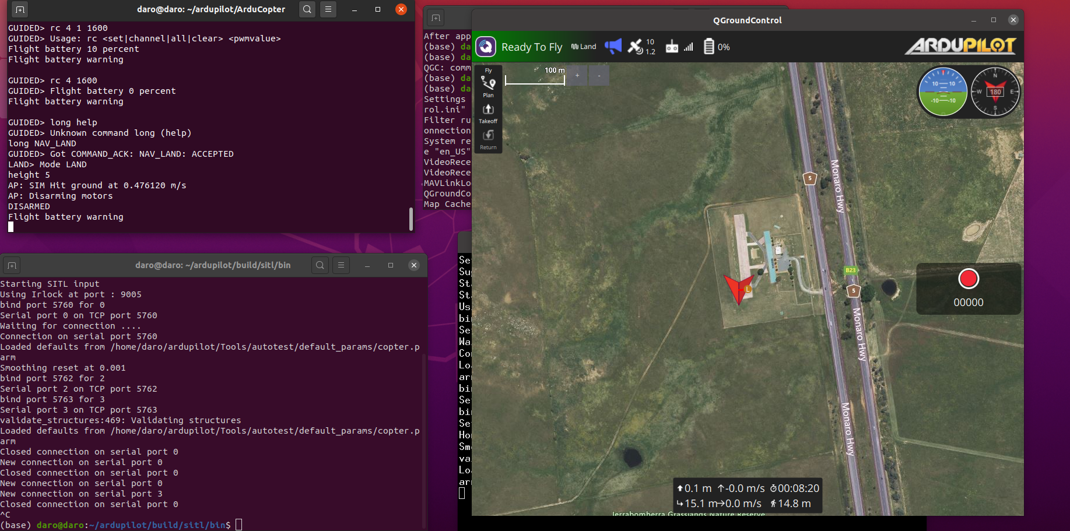
Ground Control Station
Connecting QGroundControl to SITL drone

Slide 21
MAVLink
Standardize the communication protocol for sending information
Standardize the types of messages that can be sent
Allow for bi-directional communication between GCS and drone

Slide 22
DroneKit
Four lines of code is all that is needed to do the following: arm the drone, takeoff to the specified attitude, fly to some GPS waypoint and then land.
When executed, the human readable code automatically creates the MAVLink messages required for us to fly the desires location
Vehicle.arm_and_takeoff(10)
Vehicle.simple_goto(waypoint)
time.sleep(10)
Vehicle.mode(VehicleMode’LAND’)
Install DroneKit
https://dronekit-python.readthedocs.io/en/latest/develop/installation.html

Slide 23
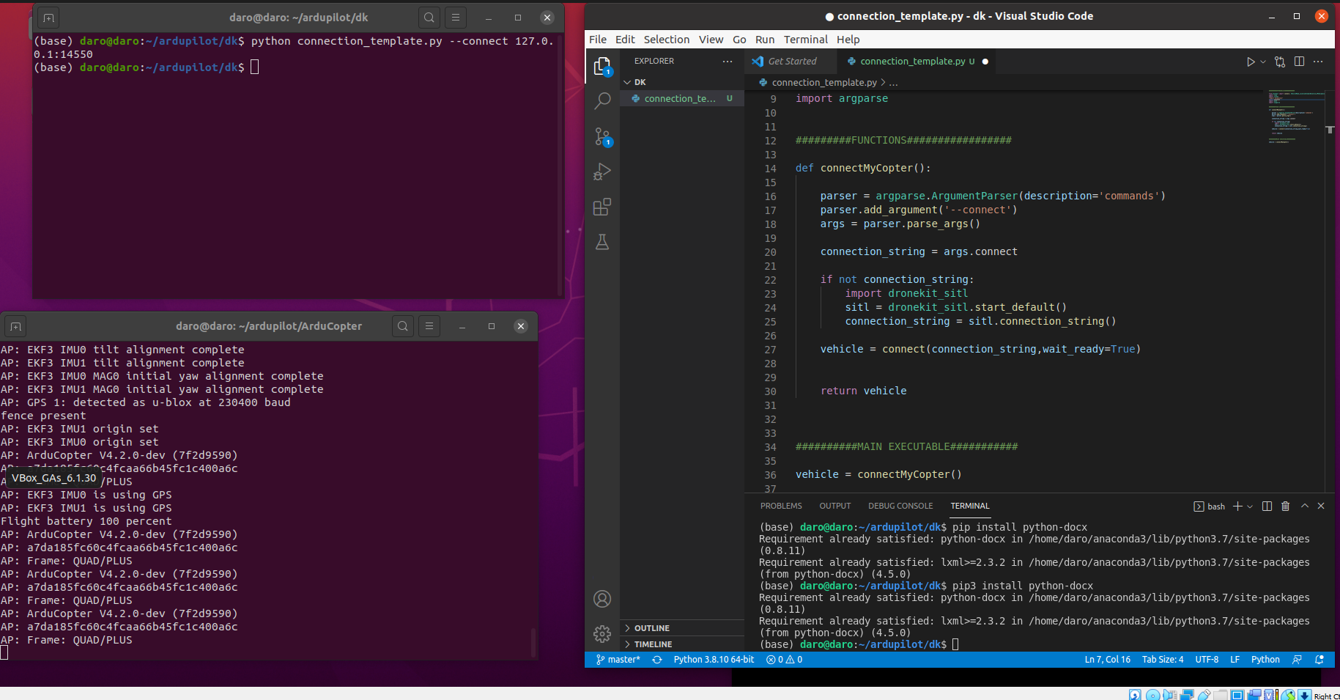
DroneKit
Connection template

Slide 24
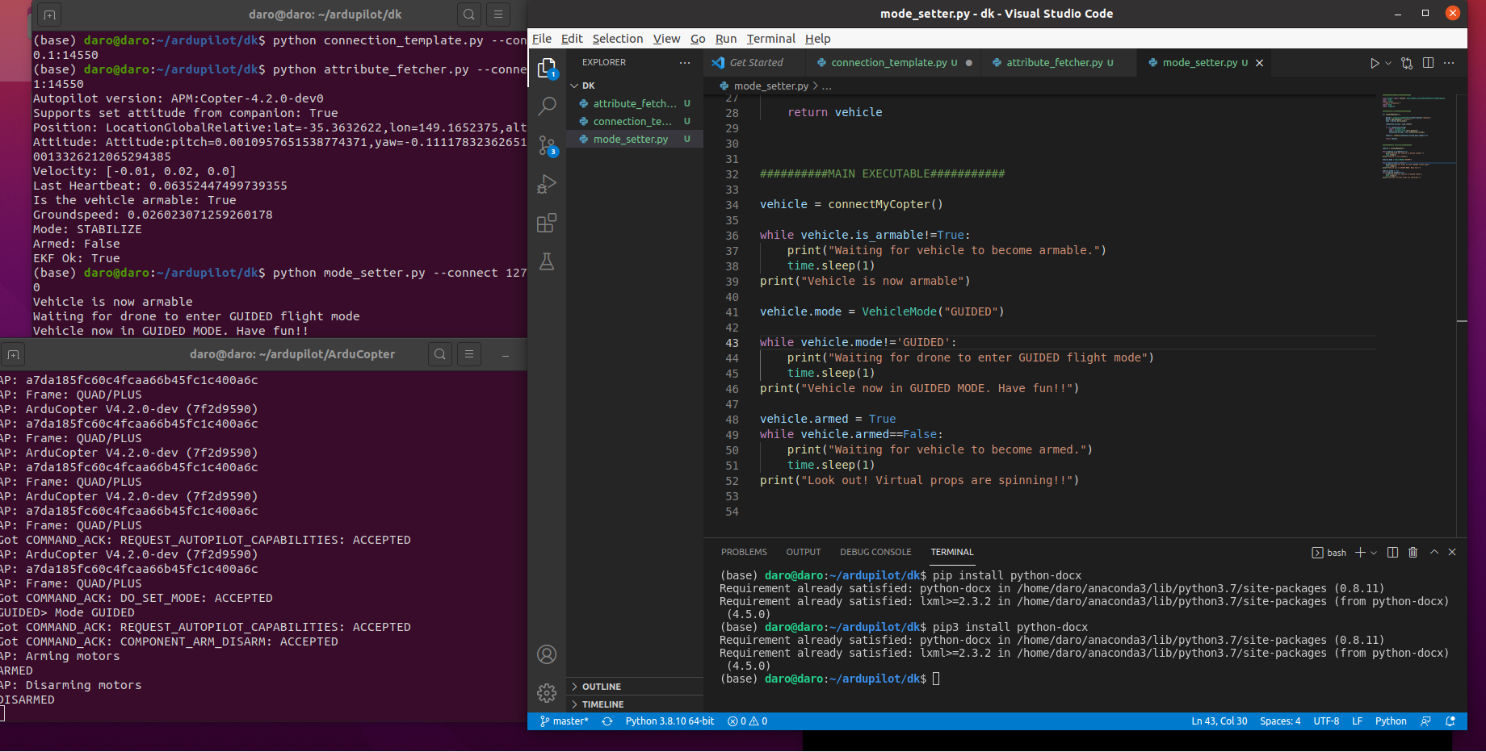
DroneKit
Setting fly mode
python mode_setter.py --connect 127.0.0.1:14550

Slide 25
DroneKit
DroneKit parameters
Key information:
To access a parameter: vehicle.parameters['PARAM_NAME’]
Example: gps_type = vehicle.parameters['GPS_TYPE’]
To write a new parameter value: vehicle.parameters['PARAM_NAME']=<VALUE>
Example: vehicle.parameters['GPS_TYPE’]=3
Full list of ardupilot parameters and descriptons:http://ardupilot.org/copter/docs/parameters.html

Slide 26
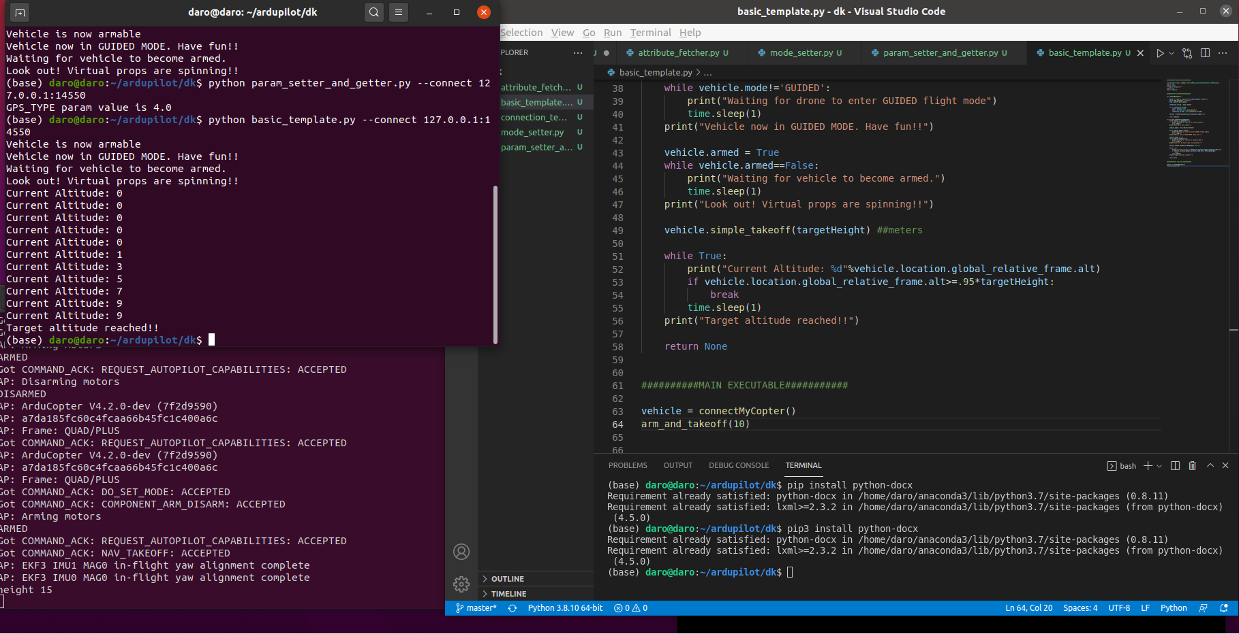
DroneKit
Armed and takeoff

Slide 27
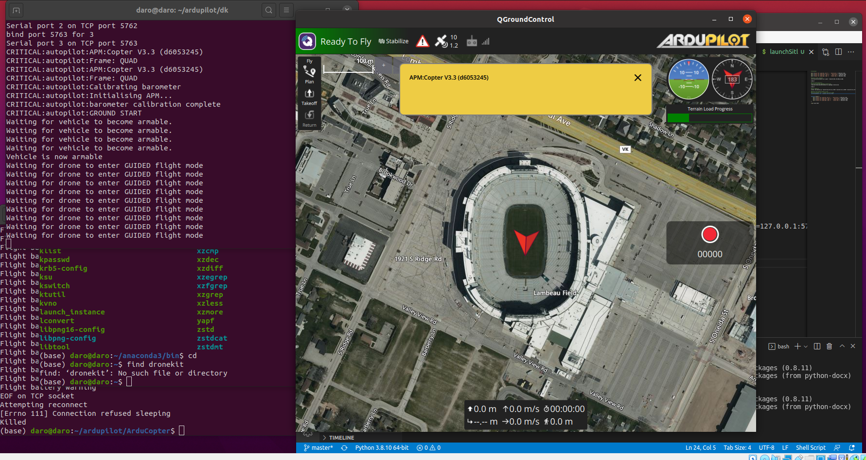
DroneKit
Script to automatically launch QGroundControl with DroneKit
What is the bash script going to do? 4 things:
Start our dronekit-sitl instance
Launch QGC
Start MAVProxy and create additional ports that can connect to the sitl drone
Launch our python/dronekit script

Slide 28
DroneKit
Script to automatically launch QGroundControl with DroneKit

Slide 29
Building PX4 Firmware

Slide 30
Outline
Setting up the hybrid environment
Building PX4 Firmware
Deploying on the hardware

Slide 31
Setting up the hybrid environment
Obtaining and setting up the codebase
Create a Github account (done)
Finding and forking the PX4 repository
Cloning the forked repository to the local machine
Rolling back to the specific release
Using the integrated development environment to navigate and edit code.
Updating the .gitignore file.

Slide 32
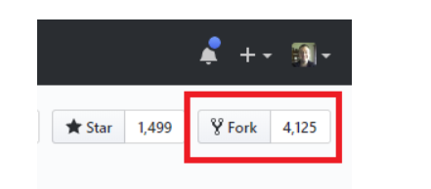
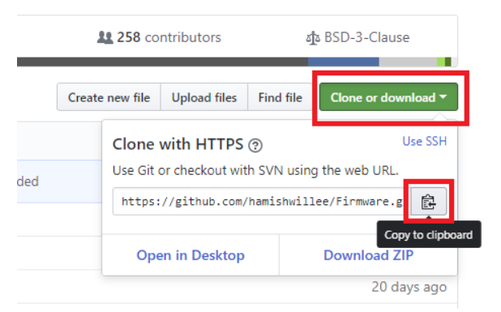
Setting up the hybrid environment
Obtaining and setting up the codebase
Finding and forking the PX4 repository
Sign up to Github
Go to the PX4 firmware repository and click on fork on the left hand side
Copy the repository URL for your Firmware repository fork. The easiest way to do this is to click the Clone or download button and then copy the URL:
Or follow this: https://dev.px4.io/v1.10_noredirect/en/setup/building_px4.html

Slide 33
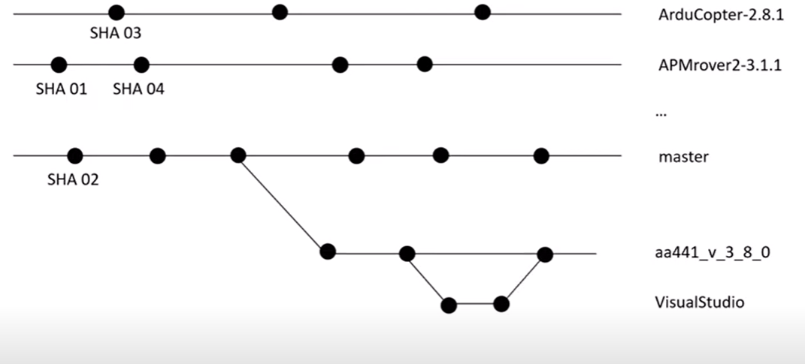
Setting up the hybrid environment
Obtaining and setting up the codebase
Example on how to get to the specific version

Slide 34
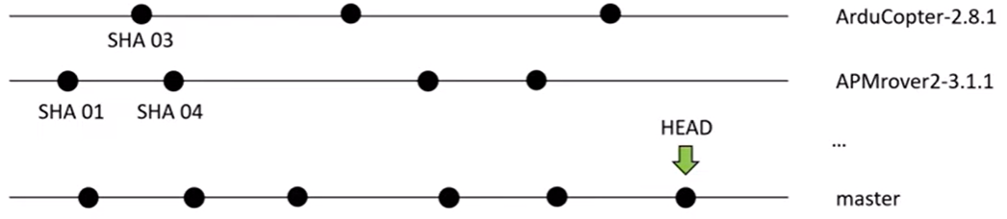
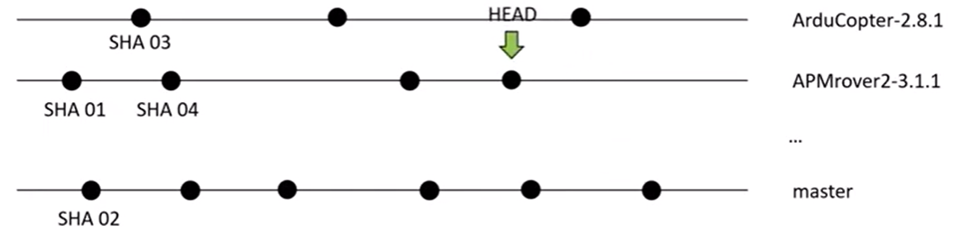
Setting up the hybrid environment
Obtaining and setting up the codebase
Example on how to get to the specific version
$ git checkout APMrover2-3.1.1

Slide 35
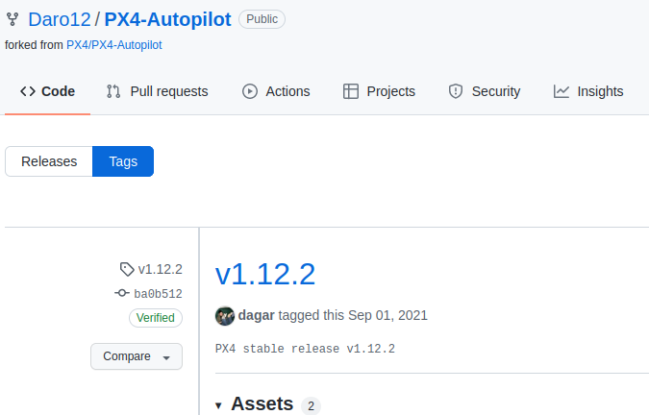
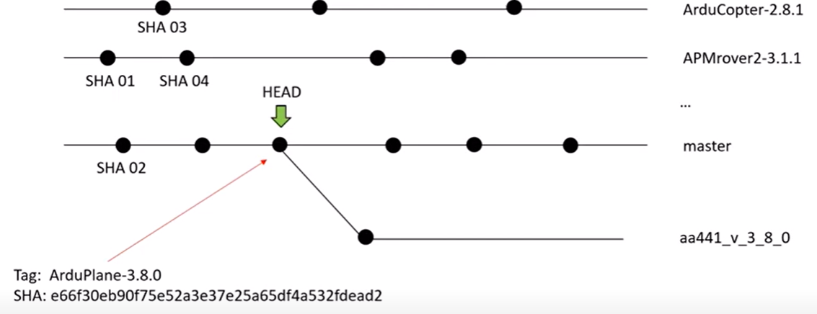
Setting up the hybrid environment
Obtaining and setting up the codebase
Example on how to get to the specific version
We need to find the SHA associated with the version we want to build. In this case v1.12.2
We want to roll back to v1.12.2 (we can also get the SHA). We use
$git checkout –b <BranchName> <SHA> Ex BranchName = daro-test-001-demo

Slide 36
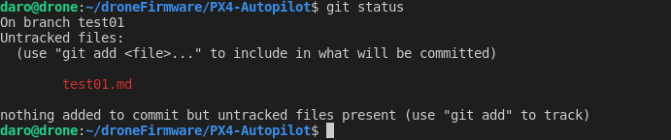
Setting up the hybrid environment
Obtaining and setting up the codebase
Example on how to get to the specific version
Use
$ git status
To check if it is there. Then
$ git add –A
$ git commit –m “first commit” This is commit locally
$ git push origin daro-test-001-demo

Slide 37
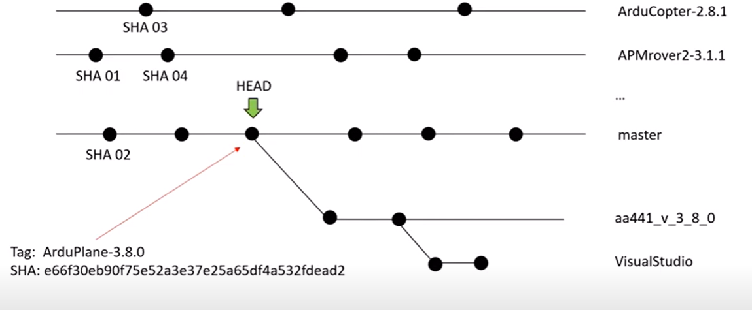
Setting up the hybrid environment
Obtaining and setting up the codebase
Example on how to get to the specific version
We want to create a branch in visual studio(this photo is just an example)
$ git branch visualStudio
$ git –a to check the branch
$ git checkout visualStudio get to the visualStudio branch

Slide 38
Building PX4 Firmware
Installation Step
https://docs.px4.io/master/en/dev_setup/dev_env_linux_ubuntu.html
$ sudo apt-get install git
$ git clone https://github.com/PX4/Firmware.git --recursive
$ bash ./PX4-Autopilot/Tools/setup/ubuntu.sh
$ sudo reboot now
$ make px4_sitl jmavsim
The simulator should running now, make sure you run QgroundControl
$ commander takeoff

Slide 39
Building PX4 Firmware

